Slide 1


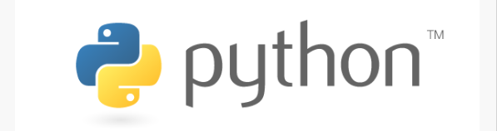
PYTHON Programming-II
By: Surendrakc

Slide 2
mODULE
Now, if we are using the same function in different programs, we won’t have to define it again and again. We can just create a script containing that function and import that script in every program that makes use of that function. These scripts are called modules in Python
Consider a module to be the same as a code library.
A file containing a set of functions you want to include in your application.
A python module can be defined as a python program file which contains a python code including python functions, class, or variables
we can say that our python code file saved with the extension (.py) is treated as the module
To use the functionality of one module into another, we must have to import the specific module.

Slide 3
MODULE
Example
In this example, we will create a module named as file.py which contains a function func that contains a code to print some message on the console.
Let's create the module named as file.py.
#displayMsg prints a message to the name being passed.
def displayMsg(name)
print("Hi "+name);

Slide 4
Loading the module in our python code
We need to load the module in our python code to use its functionality. Python provides two types of statements as defined below.
The import statement:The import statement is used to import all the functionality of one module into another.
import module1,module2,........ module n
Example:
import file;
name = input("Enter the name?")
file.displayMsg(name)
The from-import statement

Slide 5
The from-import statement
Instead of importing the whole module into the namespace, python provides the flexibility to import only the specific attributes of a module
from < module-name> import <name 1>, <name 2>..,<name n>
calculation.py:
#place the code in the calculation.py
def summation(a,b):
return a+b
def multiplication(a,b):
return a*b;
def divide(a,b):
return a/b;

Slide 6
Main.py:
from calculation import summation
#it will import only the summation() from calculation.py
a = int(input("Enter the first number"))
b = int(input("Enter the second number"))
print("Sum = ",summation(a,b)) #we do not need to specify the module name while accessing summation()
The from...import statement is always better to use if we know the attributes to be imported from the module in advance. It doesn't let our code to be heavier. We can also import all the attributes from a module by using *.
Consider the following syntax.
from <module> import *

Slide 7
import <module-name> as <specific-name>
#the module calculation of previous example is imported in this example as cal.
import calculation as cal;
a = int(input("Enter a?"));
b = int(input("Enter b?"));
print("Sum = ",cal.summation(a,b))
Using dir() function
The dir() function returns a sorted list of names defined in the passed module. This list contains all the sub-modules, variables and functions defined in this module.

Slide 8
MATH.PI
MATH.SQRT(25)
MATH.FACTORIAL(5)
Random.random()
Print(random.random()*100)
List=[1,33,4,33]
Print(random.choice(list)

Slide 9
Python Exceptions
Exception error occurs when syntactically correct code throws an error.
Errors detected during execution are called exceptions
Division by zero
Accessing the file that doesn’t occur
Operation of incompatible data types
Atm withdrawal of amount more than that in account
Whenever an exception occurs, the program halts the execution, and thus the further code is not executed.
Python provides us with the way to handle the Exception so that the other part of the code can be executed without any disruption. However, if we do not handle the exception, the interpreter doesn't execute all the code that exists after the that.

Slide 10
Common exceptions
A list of common exceptions that can be thrown from a normal python program is given below.
ZeroDivisionError: Occurs when a number is divided by zero.
NameError: It occurs when a name is not found. It may be local or global.
IndentationError: If incorrect indentation is given.
IOError: It occurs when Input Output operation fails.
EOFError: It occurs when the end of the file is reached, and yet operations are being performed.

Slide 11
Example
The try block will generate an exception, because x is not defined:
try: print(x) except: print("An exception occurred")
……………………………………………………………………………………
Print(x)
#without try except block, this statement will raise and error and program will crash
You can define as many exception blocks as you want.
Print one message if the try block raise a NameError and another for other errors
Try:
print(x)
Except NameError:
print(“variable x is not defined”)
Except:
print(“something else went wrong)

Slide 12
Problem without handling exceptions
Example
a = int(input("Enter a:"))
b = int(input("Enter b:"))
c = a/b;
print("a/b = %D"%c)
#other code:
print("Hi I am other part of the program")

Slide 13
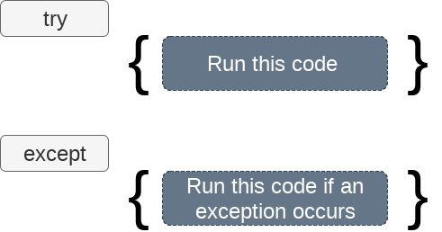
Exception handling in python
If the python program contains suspicious code that may throw the exception, we must place that code in the try block
The try block must be followed with the except statement which contains a block of code that will be executed if there is some exception in the try block.
Syntax
try:
#block of code
except Exception1:
#block of code
except Exception2:
#block of code
#other code

Slide 14
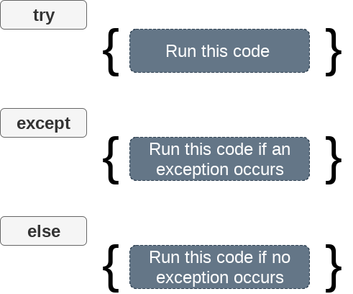
We can also use the else statement with the try-except statement in which, we can place the code which will be executed in the scenario if no exception occurs in the try block.
The syntax to use the else statement with the try-except statement is given below.
try:
#block of code
except Exception1:
#block of code
else:
#this code executes if no except block is executed

Slide 15
Example
try:
a = int(input("Enter a:"))
b = int(input("Enter b:"))
c = a/b;
print("a/b = %d"%c)
except Exception:
print("can't divide by zero")
else:
print("Hi I am else block")

Slide 16
Python provides the flexibility not to specify the name of exception with the except statement.
Example
try:
a = int(input("Enter a:"))
b = int(input("Enter b:"))
c = a/b;
print("a/b = %d"%c)
except:
print("can't divide by zero")
else:
print("Hi I am else block")

Slide 17
Example
try:
#this will throw an exception if the file doesn't exist.
fileptr = open("file.txt","r")
except IOError:
print("File not found")
else:
print("The file opened successfully")
fileptr.close()

Slide 18
Finally
The finally block, if specified, will be executed regardless if the try block raises an error or not.
try: print(x) except: print("Something went wrong") finally: print("The 'try except' is finished")
syntax
try:
# block of code
# this may throw an exception
finally: # block of code
# this will always be executed

Slide 19
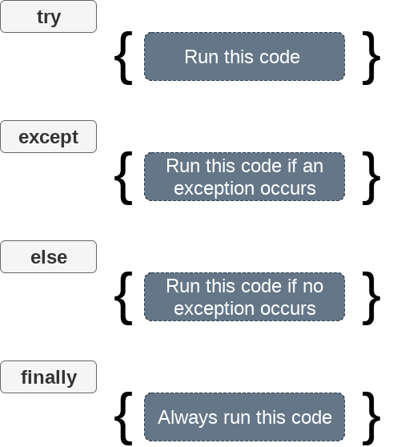

Slide 20
finally
try: f = open("demofile.txt") f.write("Lorum Ipsum") except: print("Something went wrong when writing to the file") finally: f.close()

Slide 21
Raise an exception
As a python developer, you can choose to throw an exception if the specified condition occurs.
To throw (or raise) an exception, use the raise keyword.
raise Exception_class,<value>
Points to remember
To raise an exception, raise statement is used. The exception class name follows it.
An exception can be provided with a value that can be given in the parenthesis.
To access the value "as" keyword is used. "e" is used as a reference variable which stores the value of the exception.

Slide 22
Raise an error and stop the program if x is lower than 0:
x = -1 if x < 0:
raise Exception("Sorry, no numbers below zero")
Raise a TypeError if x is not an integer:
x = "hello" if not type(x) is int:
raise TypeError("Only integers are allowed")
https://docs.python.org/3/library/exceptions.html

Slide 23
Example
try:
age = int(input("Enter the age?"))
if age<18:
raise ValueError;
else:
print("the age is valid")
except ValueError:
print("The age is not valid")

Slide 24
Example
try:
a = int(input("Enter a?"))
b = int(input("Enter b?"))
if b is 0:
raise ArithmeticError;
else:
print("a/b = ",a/b)
except ArithmeticError:
print("The value of b can't be 0")

